Slide 1
Welcome to Reception (F2) September 2023
September 2020

Slide 2
Welcome Everybody
We have two reception classes;
The Rainbow Class and The Sunshine Class
We aim to provide:
A bright and stimulating learning environment where children can be curious, explore, investigate and learn
A place where your child feels safe, secure and comfortable to learn
Class rooms where children are encouraged to care for themselves, those around them and their belongings
Where children are encouraged to be active communicators, sharing their thoughts and feelings and ask questions about the world around them

Slide 3
Start & Finish Times
Start 8:45am
Lunchtime 11.45-12.45pm
Finish 3:15pm
Before the end of the school year we will let you know VIA CLASS DOJO which class your child is in, and about the staggered start to term.

Slide 4
Working with parents
The staff in Robert Shaw Reception will always be here to support your child’s learning journey. We work closely with parents as you know your child best. Ways in which we can stay connected:
Class Dojo (we will need your email)
Brief chats during drop off and collection
Parents consultations (two times per year)
Annual school report

Slide 5
On Your Child’s First Day
On your child’s first day/week, they may be hesitant or even upset. For some, this process continues for a while.
Please be assured, that we will make sure we communicate with you to let you know how they are doing.
We know that it can be as hard for parents as it is for children.
On the first day we will invite you into the classrooms to have a brief look around and settle your child.
Notes:
No backpacks or toys

Slide 6
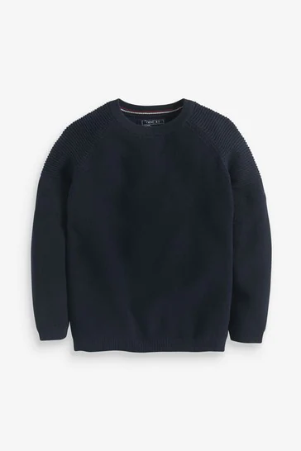
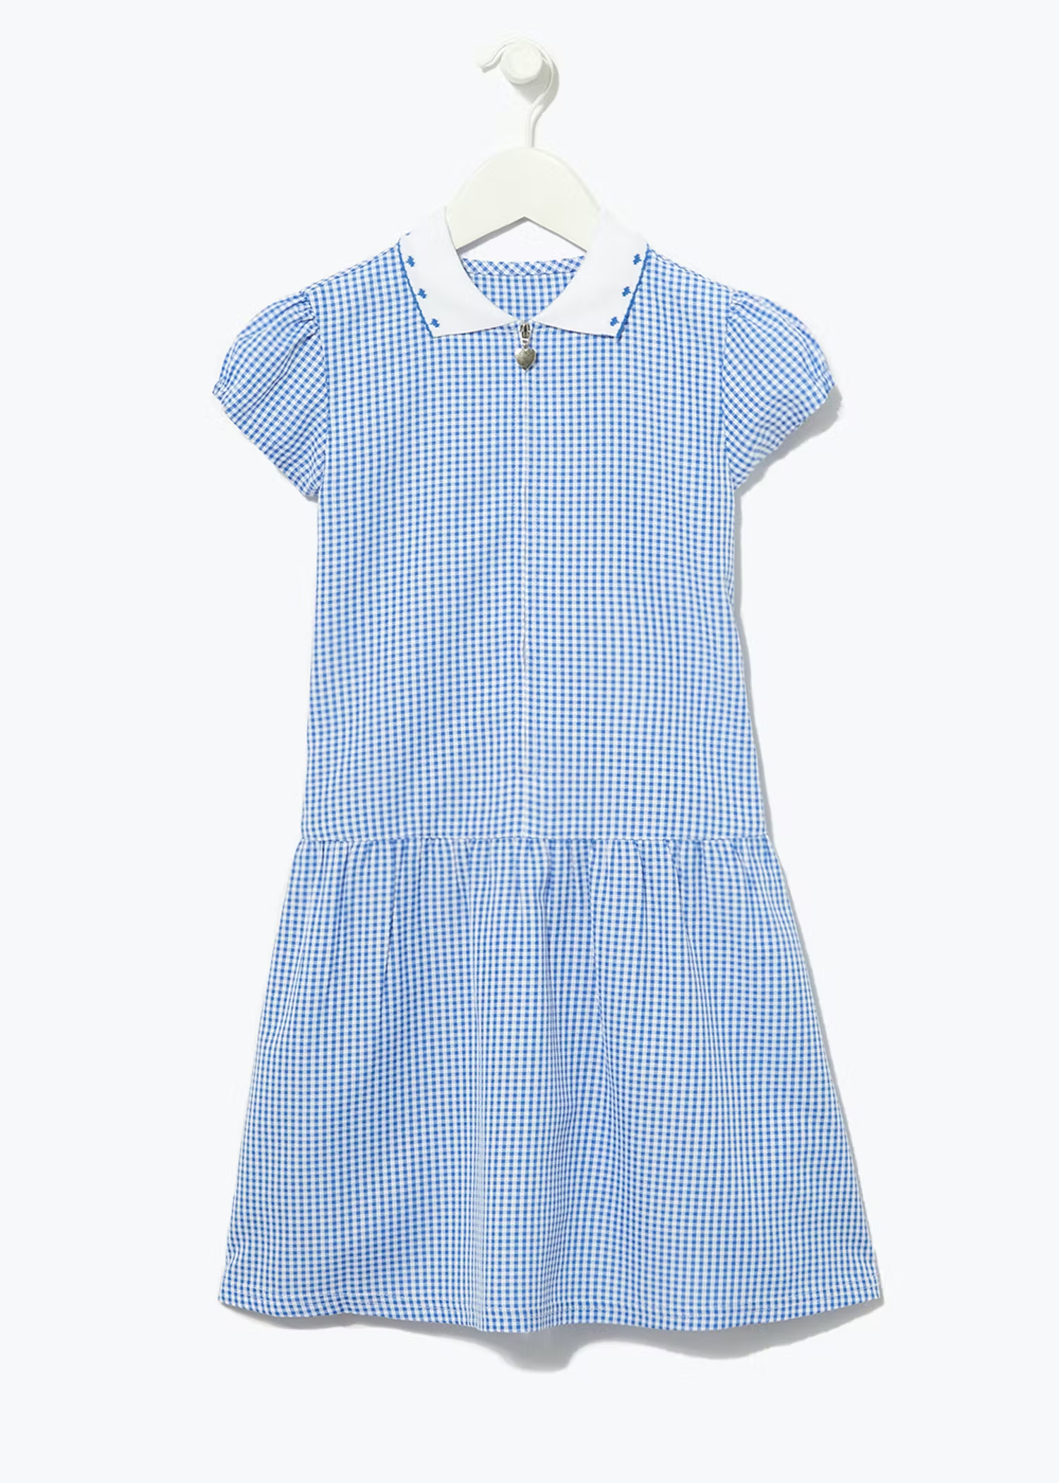
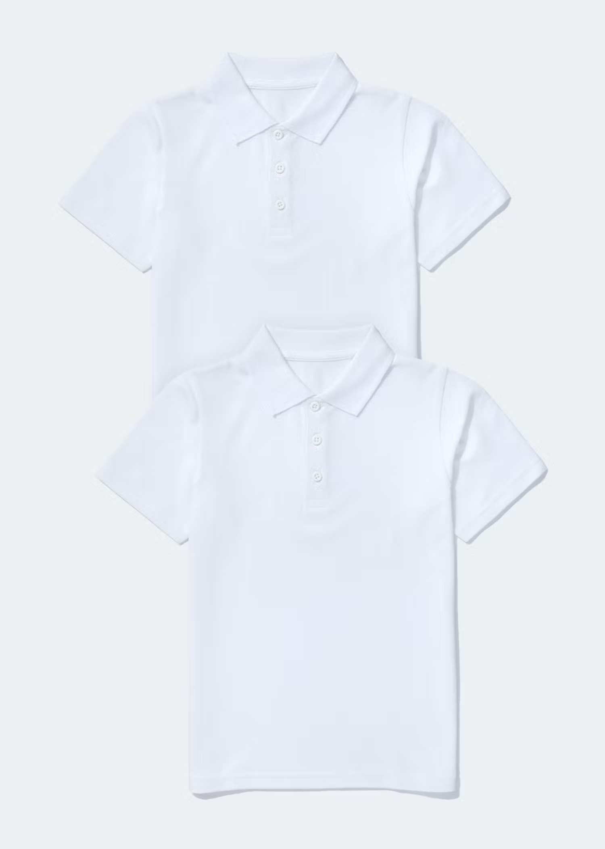
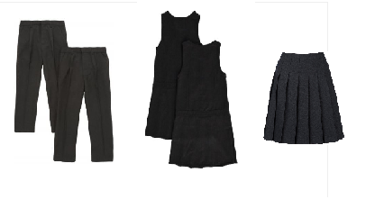
School Uniform
White shirt or Polo T-shirt.
Navy blue jumper or cardigan.
Girls wear grey/black skirt, trousers, pinafores or blue and white summer dress.
Boys wear grey/black trousers or shorts. (not jogging bottoms)
Black sensible shoes or plain black trainers.
Tops don’t need the school logo but these can be bought at the two websites below if you would like them;
https://www.schoolwearsolutions.com/product-category/our-schools/robert-shaw-primary-school/
https://myclothing.com/robert-shaw-primary-school/7927.school
Please name ALL your children’s clothing!

Slide 7
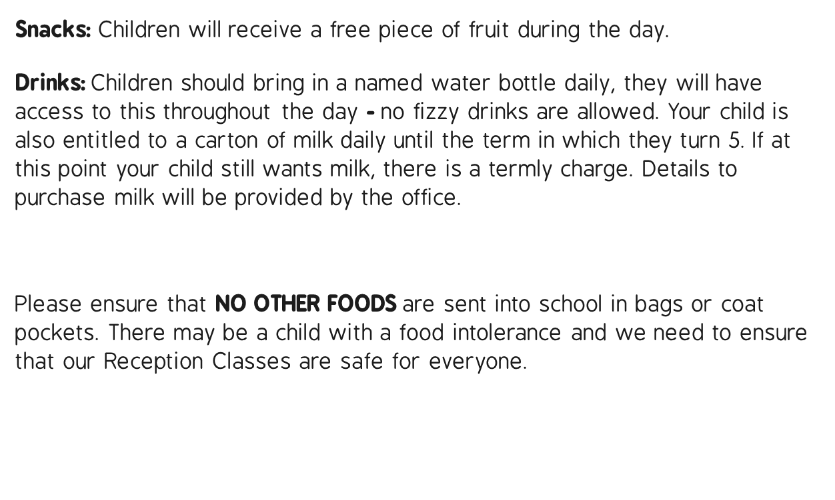
Snacks and milk

Slide 8
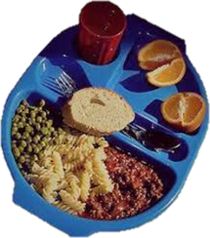
Lunchtimes
Children may bring a packed lunch from home, but we find that most choose to have a delicious and nutritious school lunch. To help the school kitchen, we ask that you give a full week's notice of any transfer from one to the other; although we can cater for an occasional school lunch in the event of a forgotten packed lunch, etc.
Vegetarian, Halal and special diets are all catered for. School lunches are free for all children in the Reception, Year 1 and Year 2 classes.
Menus for the Autumn Term will be posted on Class Dojo.
Packed lunch boxes must be clearly marked with the child's name and must be sent to school with the child in the morning.
At Robert Shaw Primary School we comply with Government healthy eating guidelines. To this end, we would ask parents whose children bring in a packed lunch contain no fizzy drinks, multiple chocolate bars or sweets.
No nuts are allowed either due to the risk of allergies.

Slide 9
Health
School needs to be aware of your child’s medical background, in particular any allergies (e.g. bee stings, dairy food), any dietary restrictions (e.g. vegetarian or Halal) and any medical conditions that are important for us to know (e.g. asthma or eczema). You will need to fill in a form for any prescribed medicines that will need administering during the school day.
Children can suddenly become ill and therefore it is important that we know we can contact you or another adult relative/friend at all times. Please ensure that the school is kept up to date with your contact details. If your child is unable to attend school due to illness, please telephone or message the school office on Dojo to let us know.
To promote good oral health and develop good speech, please ensure that your child is no longer using a dummy or drinking from bottles.

Slide 10
Toilet Training
Children should ideally be toilet trained before they start school and now is a great time to start the process.
When your child starts school we would like them to be able to:
Know how to use a toilet
Know how to wipe themselves clean when finished and flush the toilet
Be able to wash and dry their own hands
Please make sure they have a change of clothes in a bag on their peg in case of any accidents.

Slide 11
Early Years Curriculum
We carefully plan activities and lessons in order to provide a range of learning experiences. Planning for each term is carried out using a topic-based approach, following the children’s interests and responding to specific events.
There are 7 Areas of Learning in the Early Years Foundation Stage (EYFS), which activities are planned around:
Personal, Social and Emotional Development
Physical Development
Communication and Language
Literacy
Mathematics
Understanding the World
Expressive Arts and Design
At Robert Shaw the children participate in ACTIVE LEARNING, meaning that they may be inside the classroom or exploring the outside area. Children are not often sat at desks working; but investigating, exploring, designing, creating and being active. We believe this is the best way to learn and will produce well-rounded inquisitive young learners; ready for the next phase of education in Key Stage 1.
During Reception, your child will be working towards the Early Learning Goals. These describe the level of attainment expected at the end of your child’s Reception year in school.

Slide 12
Summer Learning
Recognising own name – possibly even being able to write it.
Taking off and putting on own coat.
Read stories with children and talk about the characters.
Helping with jobs around the house such as baking, putting toys away, setting the table for dinner.
Using playdough and colours to develop strong fine motor muscles ready for writing in the Autumn term.
Most importantly; HAVE FUN!

Slide 13
We hope that this presentation is useful. Should you have any questions, please feel free to speak to a member of staff.
We aim to ensure that your children’s experience in Robert Shaw Primary School is a happy and rewarding one. We look forward to working with both you and your children.
Useful Websites:
https://robertshaw.nottingham.sch.uk
https://assets.publishing.service.gov.uk/government/uploads/system/uploads/attachment_data/file/974907/EYFS_framework_-_March_2021.pdf
https://www.bbc.co.uk/cbeebies
https://hungrylittleminds.campaign.gov.uk/
https://literacytrust.org.uk/resources/time-together-multilingual-families/
https://www.pacey.org.uk/working-in-childcare/spotlight-on/being-school-ready/

Slide 14
Reminder
Tuesday 11th and Wednesday 12th July are transition days for the children to have a taster of life in Reception.
All children will attend in the morning session (9.30 to 11.15am)
Robert Shaw Morning Nursery to arrive at normal time.
We are so looking forward to meeting everyone and getting to know the children.

