Slide 1

Welcome to Reception (F2) September 2025

Slide 2
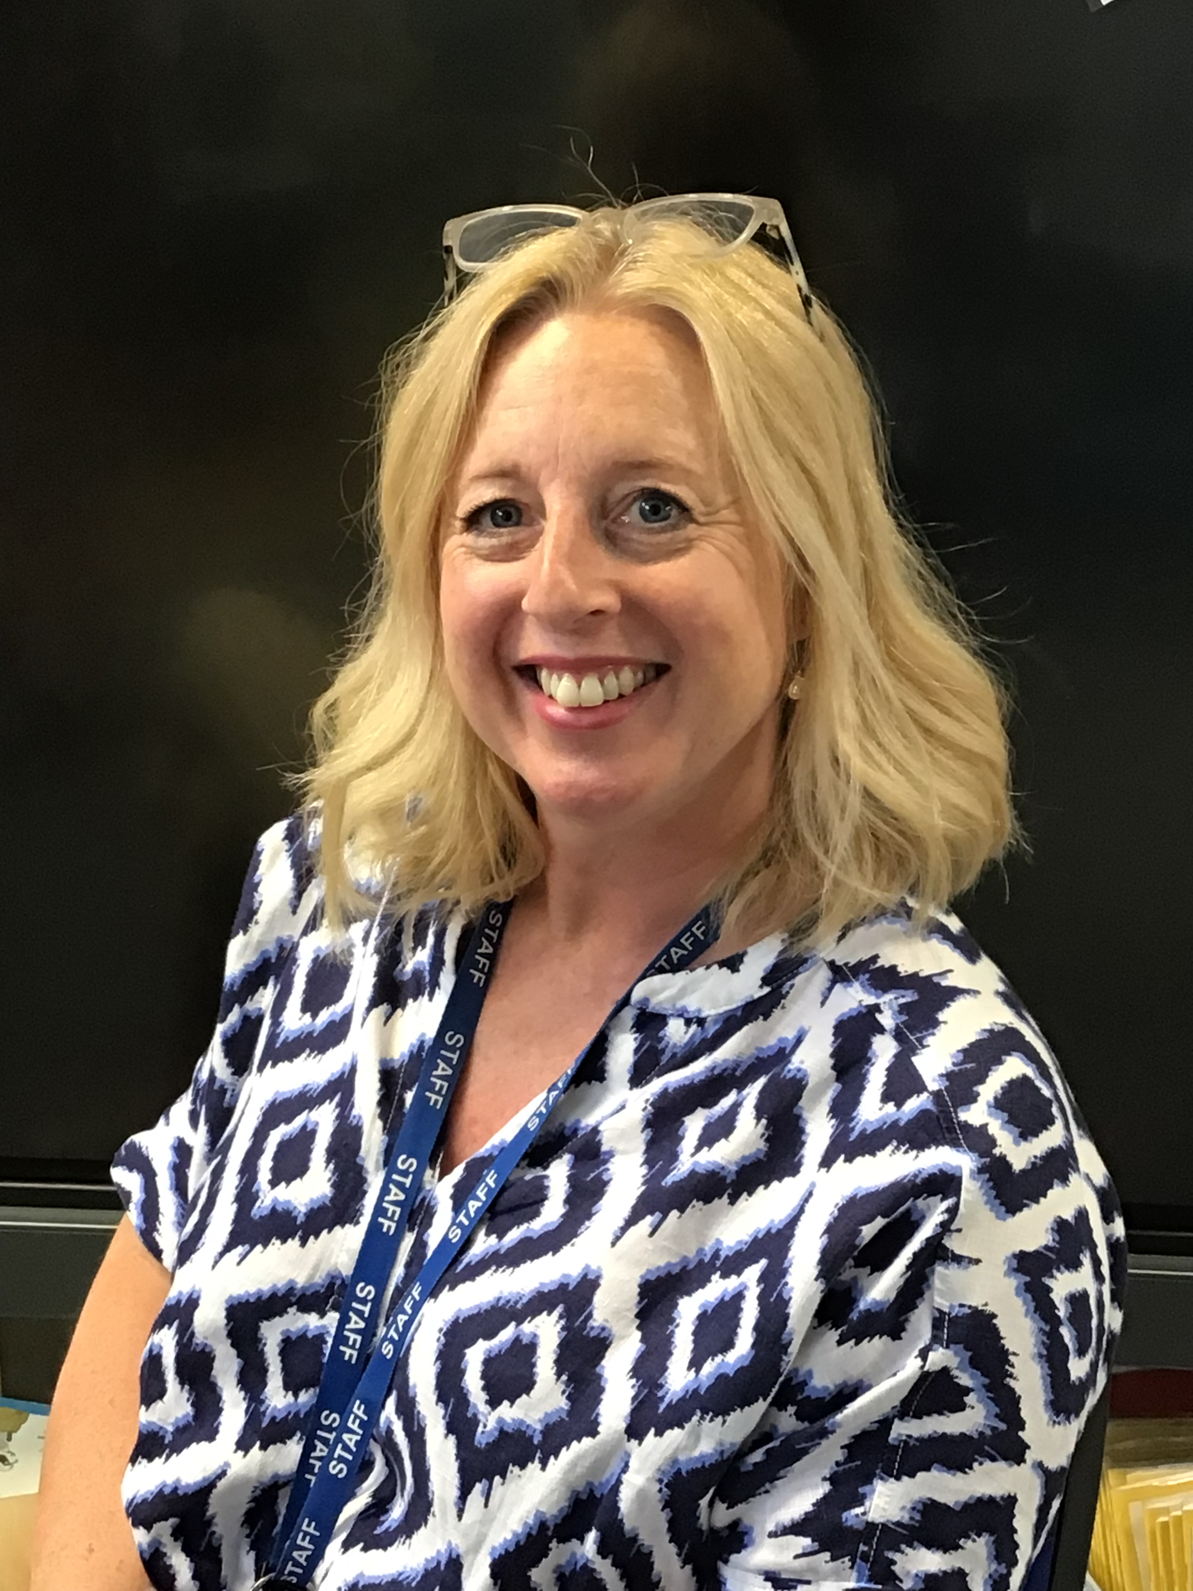
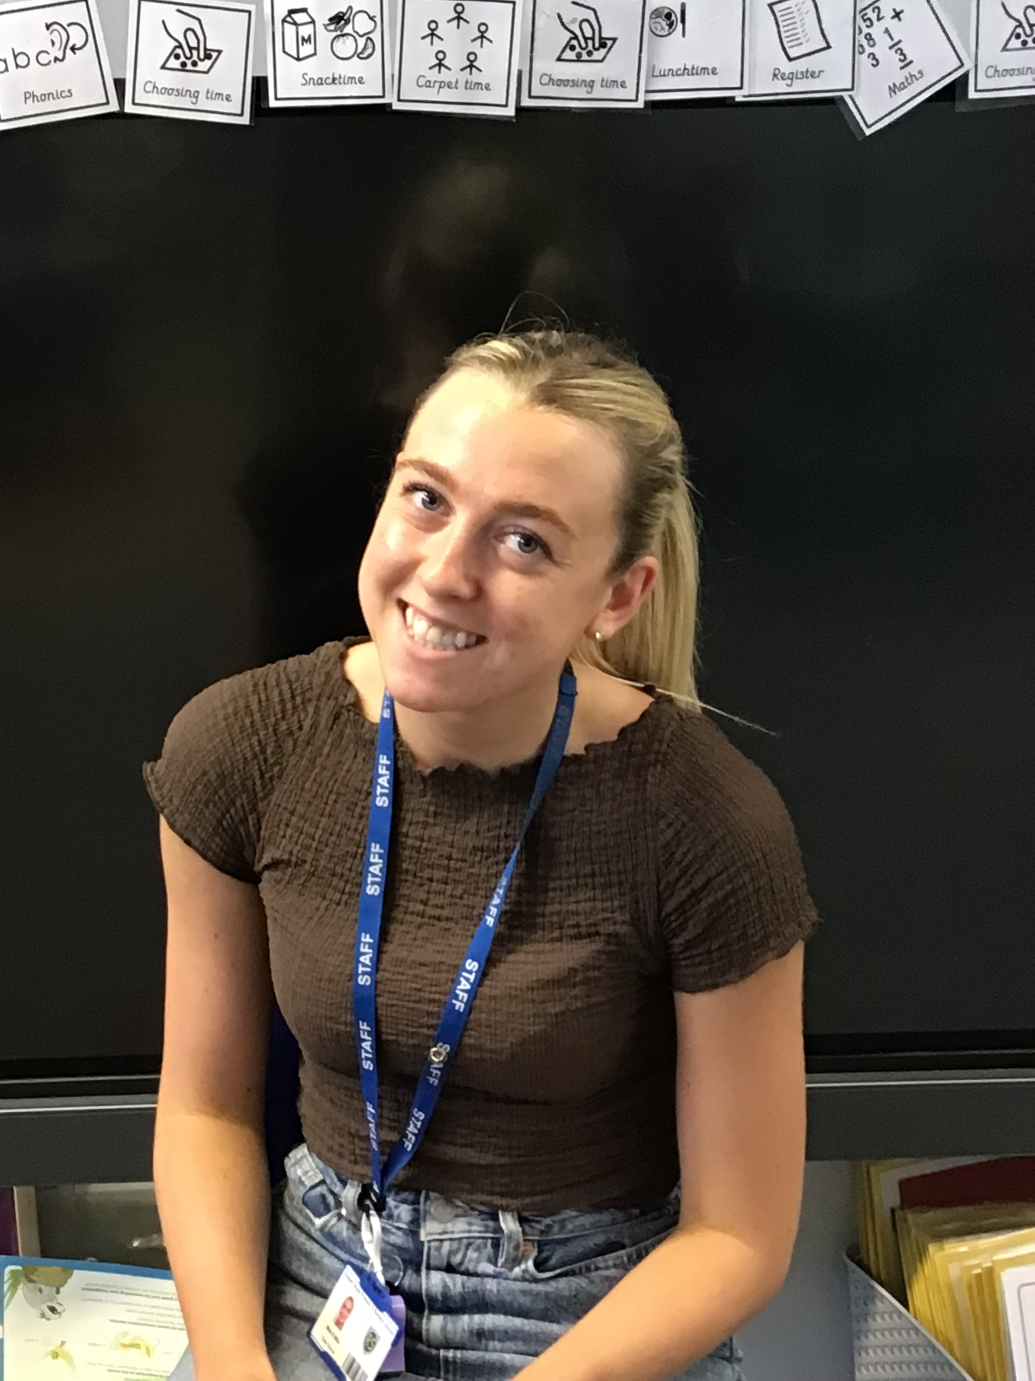
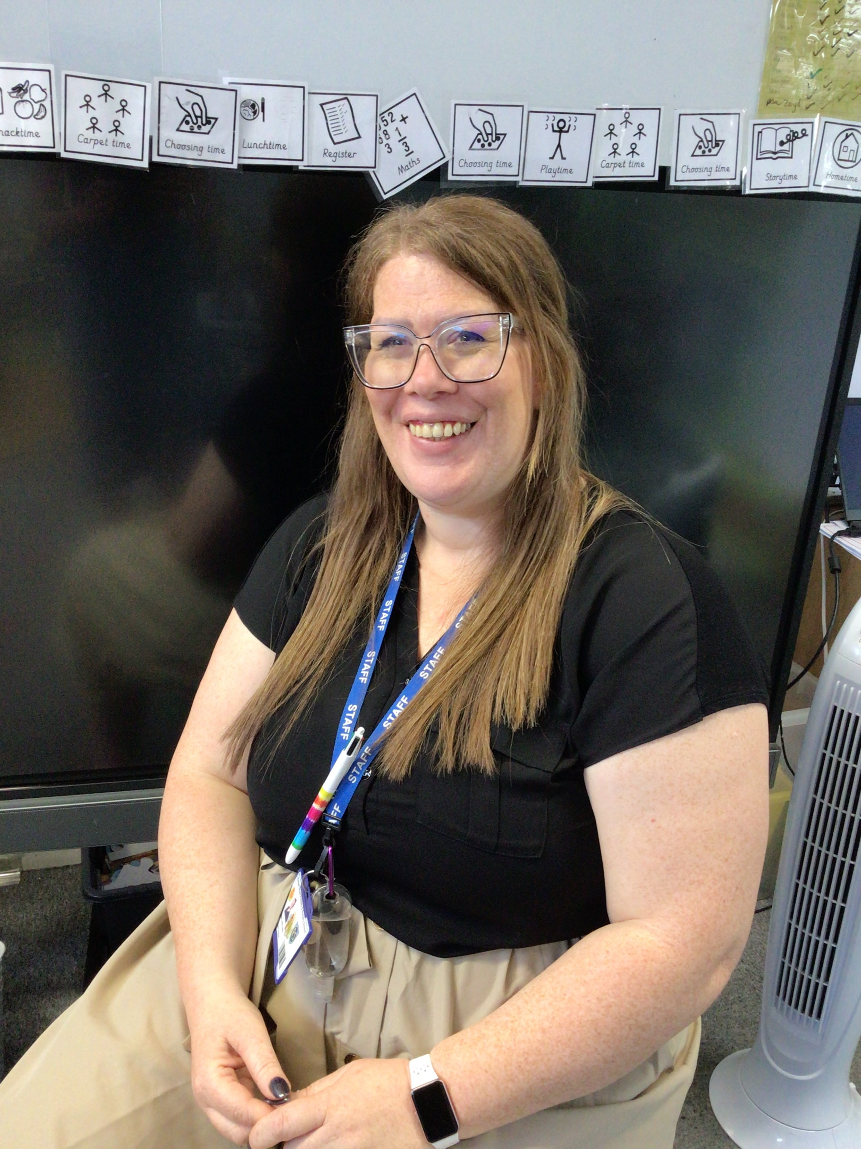
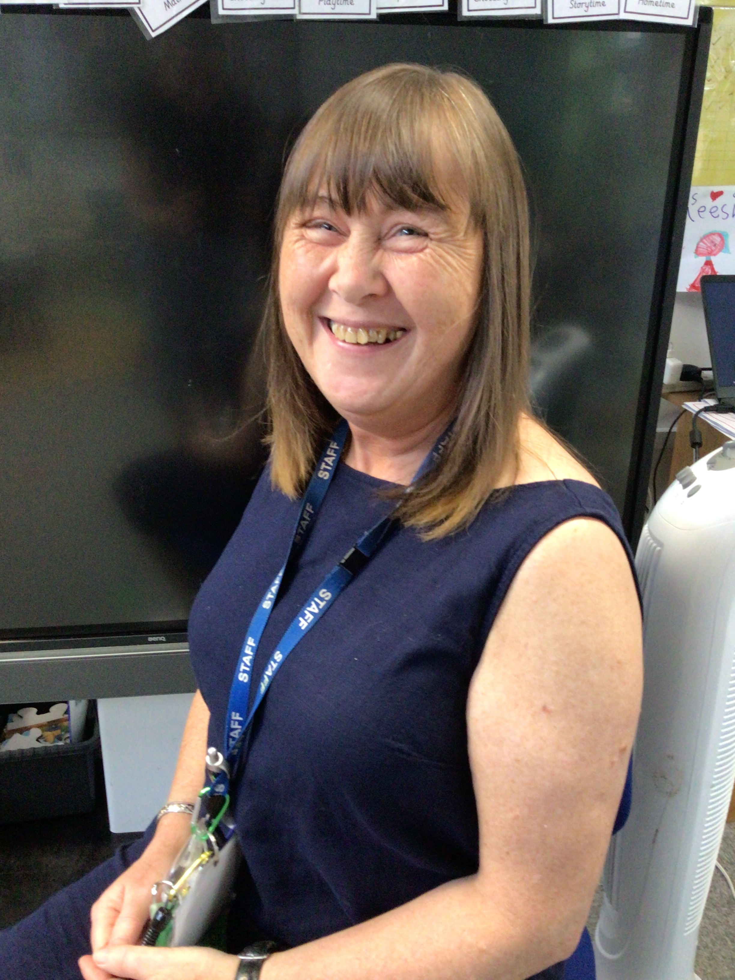
Meet the Team
Mrs Grainger
F1 teacher and EYFS lead
Miss McLeish
Sunshines teacher
Miss Mills
Rainbows teacher
Mrs Carolan
F2 Teaching assistant

Slide 3
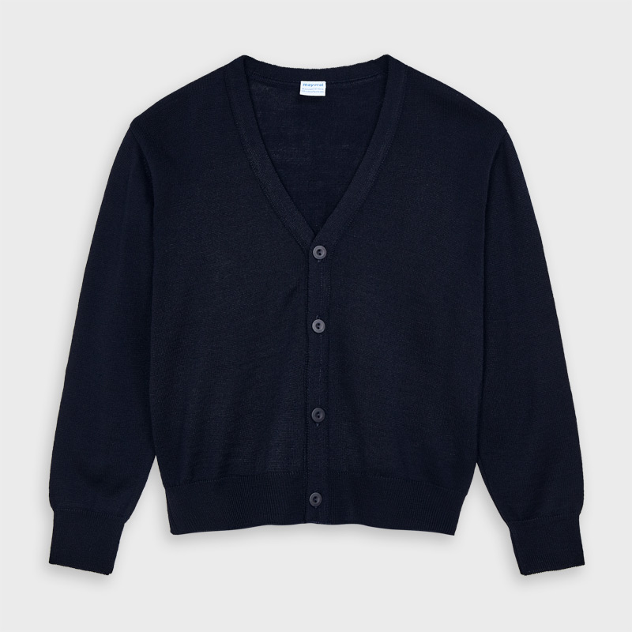
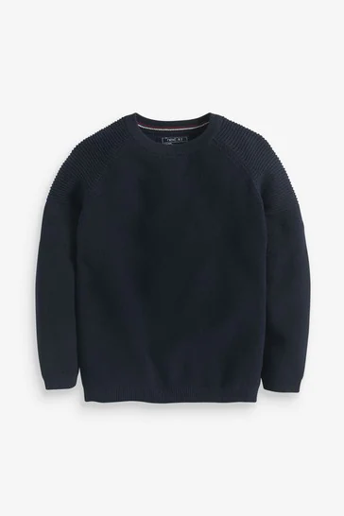
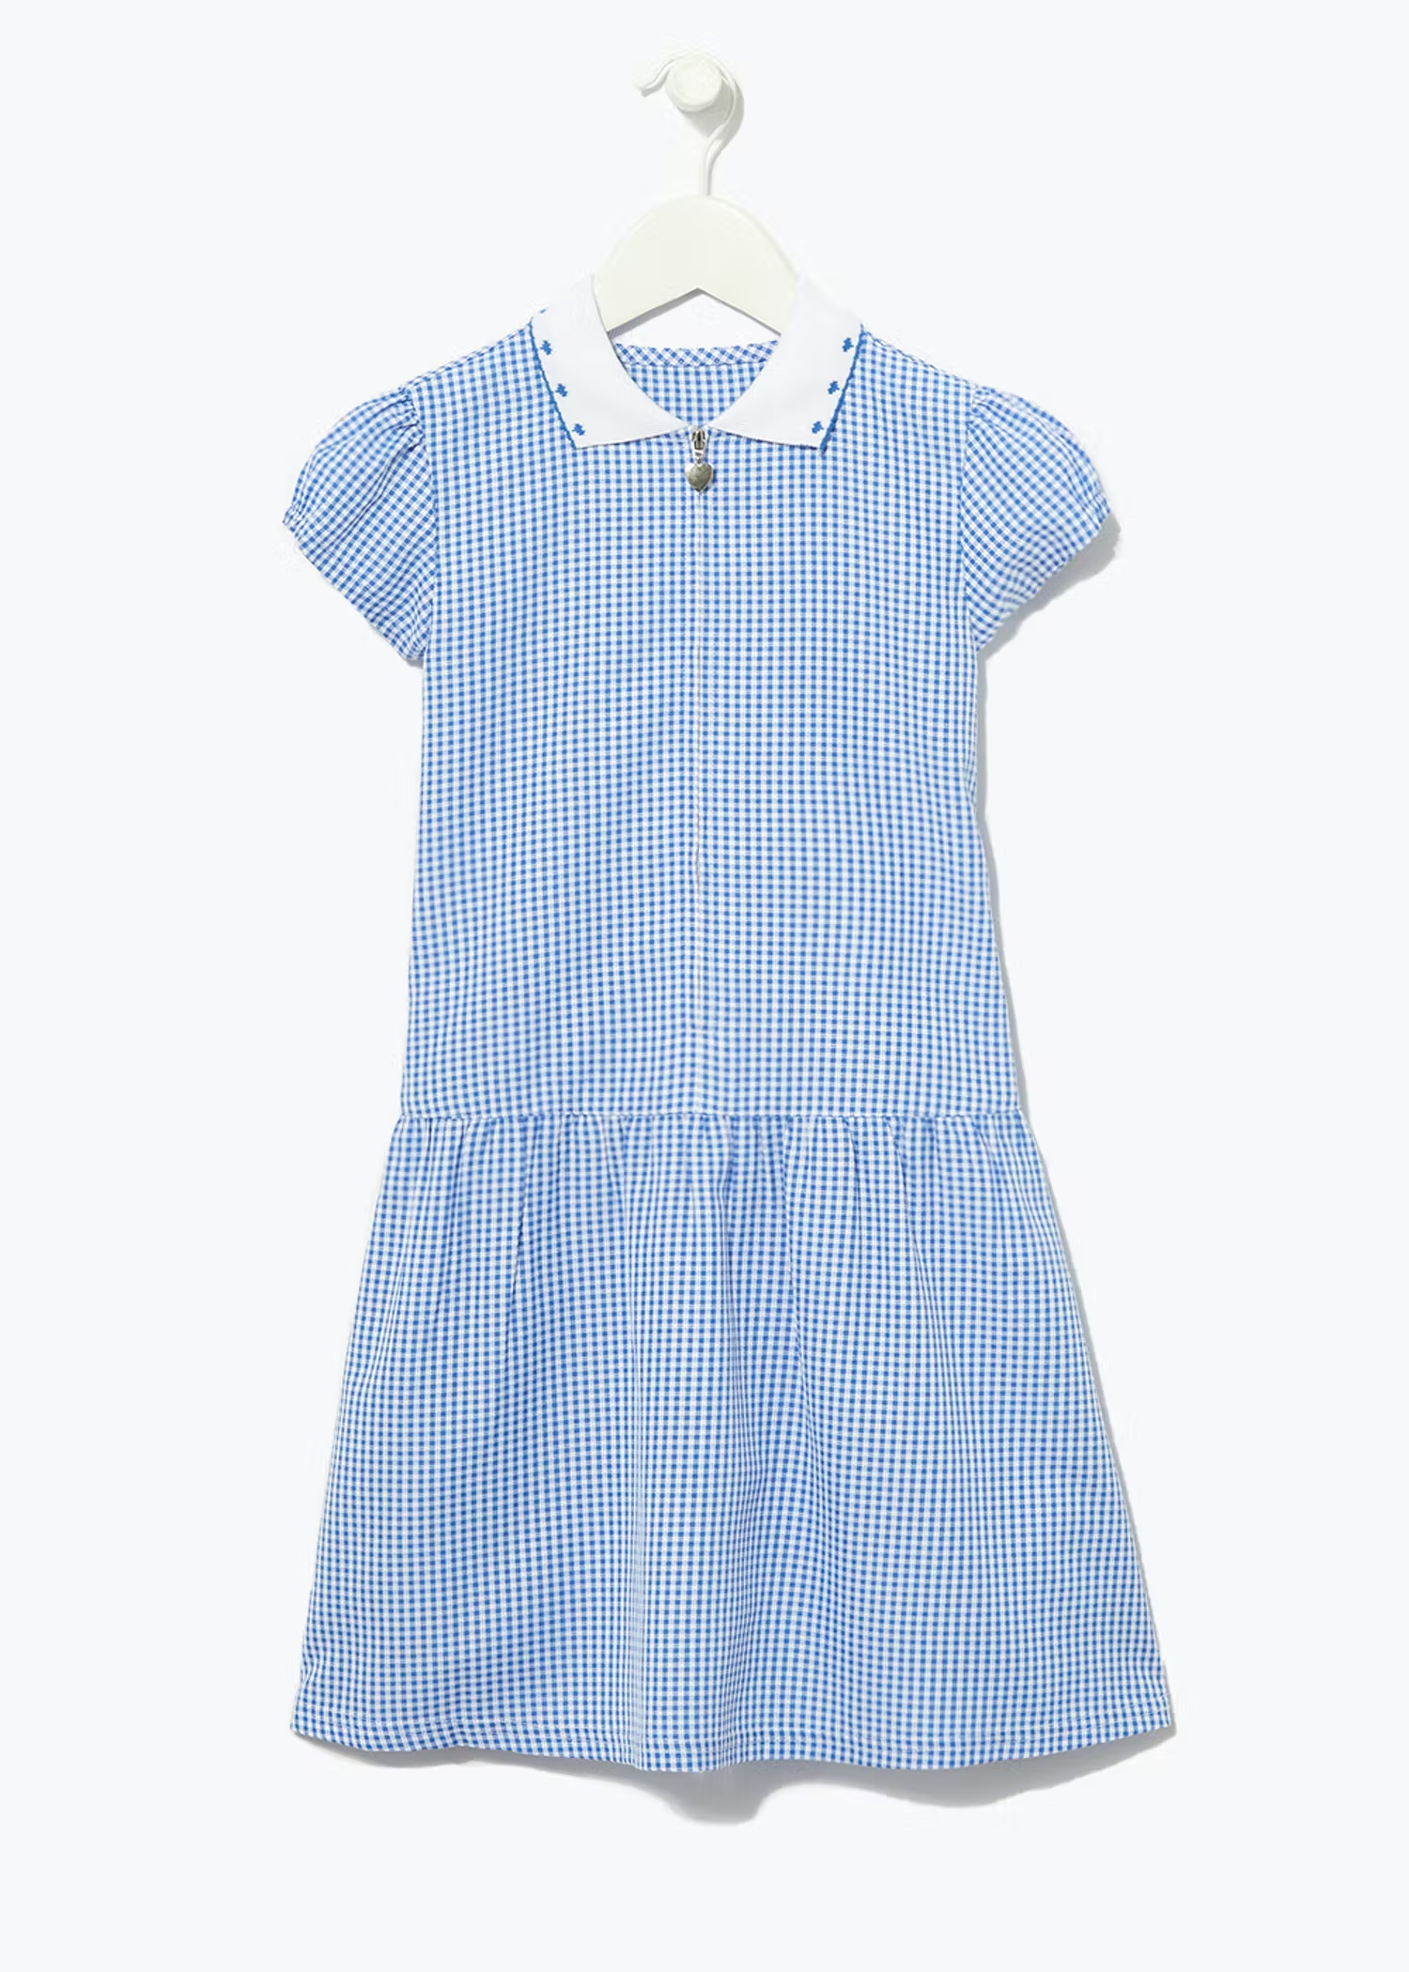
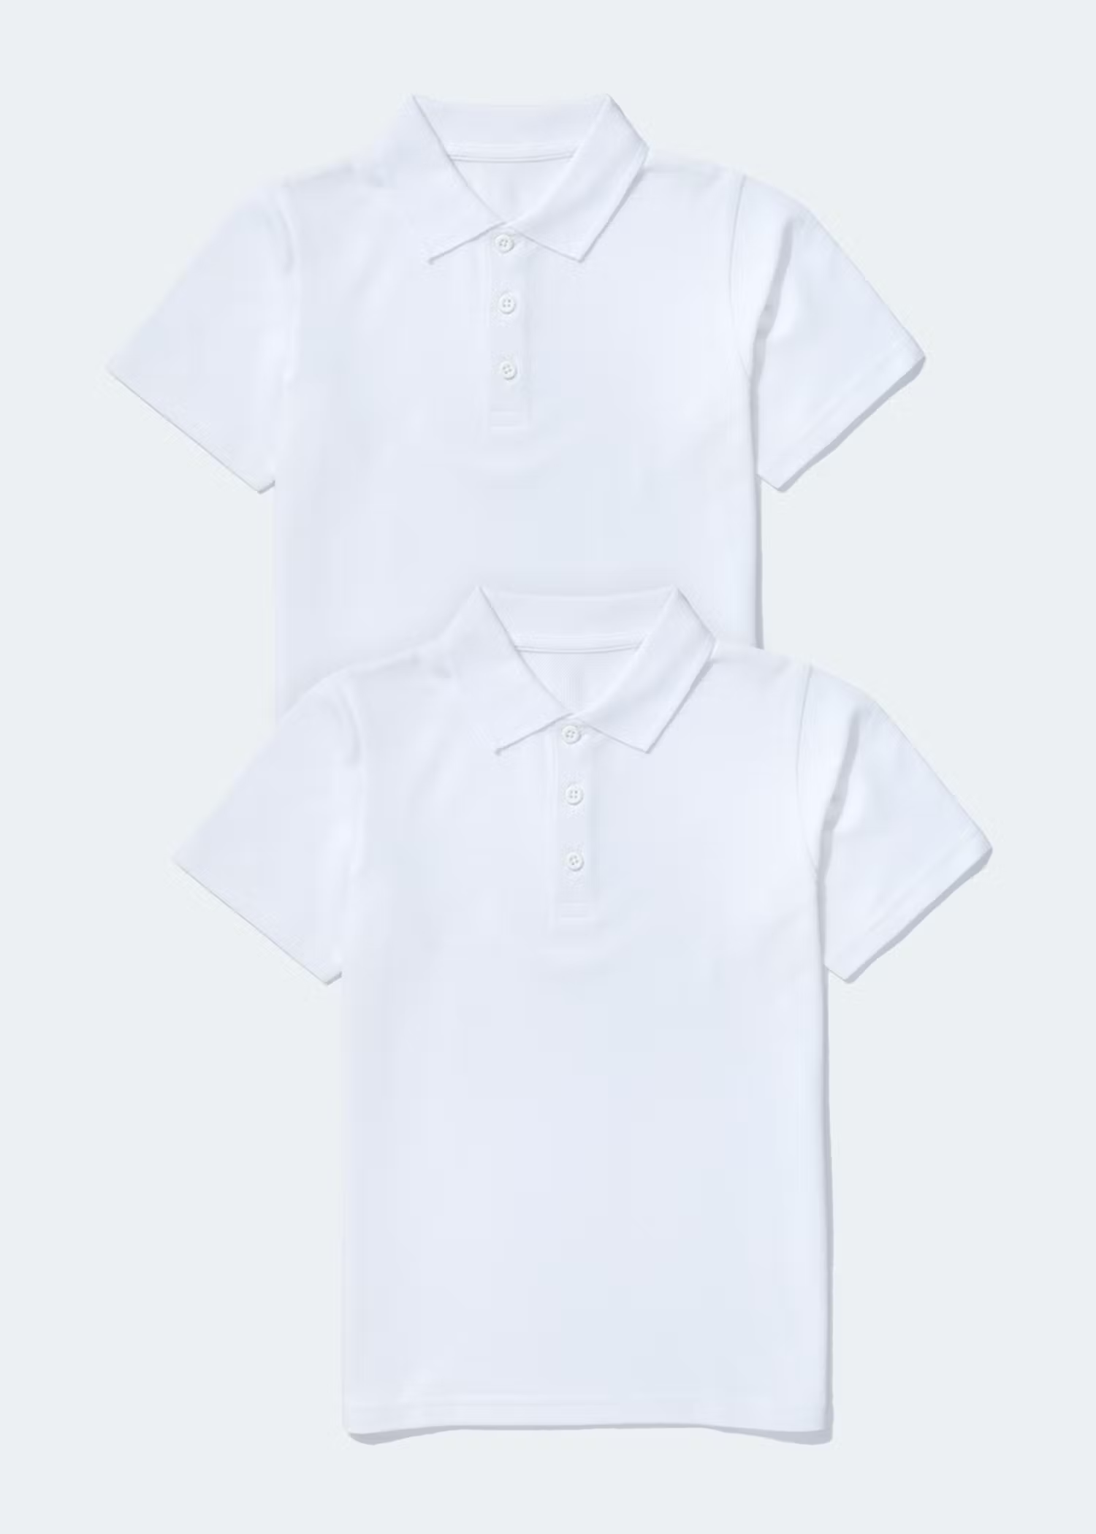
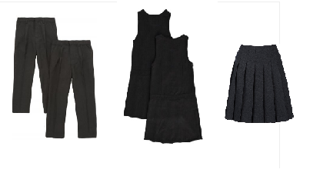

School Uniform
White or pale blue shirt or Polo T-shirt.
Navy blue jumper or cardigan.
Girls wear grey/black skirt, trousers, pinafores or blue and white summer dress.
Boys wear grey/black trousers or shorts.
Black sensible shoes or plain black trainers.
Tops don’t need the school logo but these can be bought from Morley’s School Outfitters
Please name ALL your children’s clothing!

Slide 4

Snacks and milk
Children will receive one piece of fruit/vegetable every day.
No other snacks should be brought in.
Children are entitled to free milk until they are 5 but you DO need to register for this at www.coolmilk.com The term after your child turns 5 you will need to pay.

Slide 5

Start
&
Finish Times
Start 8:45am
Lunchtime 11.45-12.45pm
Finish 3:15pm
Please join Class Dojo as we use this as our main method of communication

Slide 6
What we will learn at school – some important parts of our school day
Read, Write Inc – the phonics scheme that we use to help your child learn to read and write
https://www.ruthmiskin.com/parentsandcarers/
Handwriting – follow the link to see how we form letters correctly
https://ictgames.com/mobilePage/skyWriter/index.html
NCETM – our maths programme of study
https://www.ncetm.org.uk/in-the-classroom/early-years/
Drawing Club – to help develop our imagination, communication and fine motor skills
https://www.canigoandplaynow.com/drawing-club.html

Slide 7
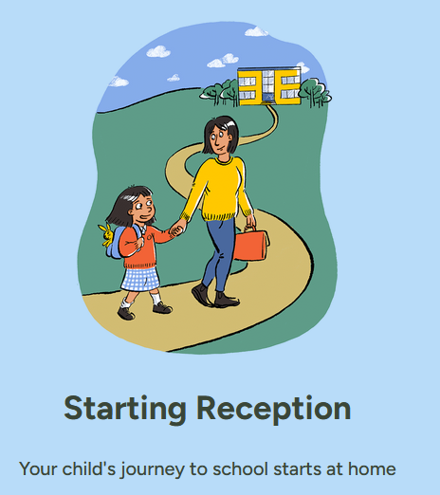
School Readiness – What is it?
Home - Starting Reception

Slide 8
Transition Days
Non Robert Shaw Nursery Children
1st July 1.00 - 2.45
2nd July 1.00 - 2.45
Please drop off and collect Via Dorothy Grove Gate
Children who already attend RS Nursery
1st July 9.15 - 11.00
2nd July 9.15 – 11.00
Arrive and collect from Nursery at normal

Slide 9
September
Monday 1st September is INSET – NO SCHOOL
Tuesday 2nd September
Wednesday 3rd September
Thursday 4th September
Friday 5th September
Group A morning session
Group B afternoon session
Group A morning session
Group B afternoon session

