Slide 1
Art across the whole school
Transform Trust

Slide 2
Intent
To inspire children to achieve their creative potential through using experimentation to find their artistic voice.
Children will be able to draw on their knowledge of artists, art forms, materials and media to achieve this.

Slide 3
Implementation
Work will be progressive and follow elements across the whole school from EYFS to Year 6.
Units of work will follow a set structure which allows children the opportunity to recall prior knowledge, build on that knowledge, practice set pieces explicitly, discover an artist’s work and find their artistic voice.

Slide 4
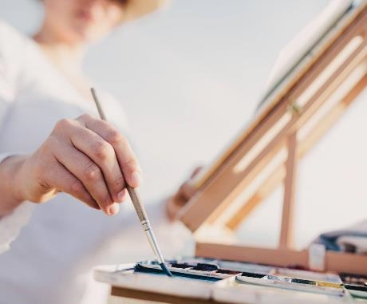
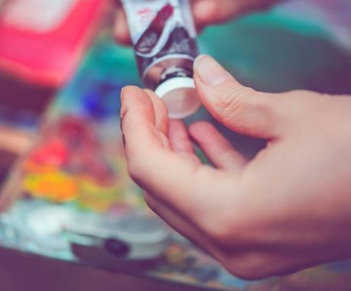
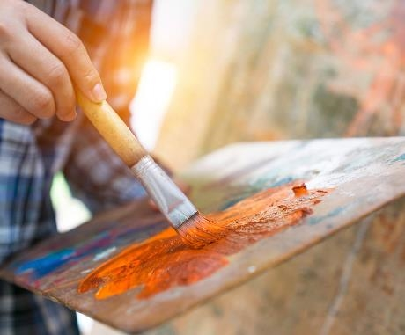
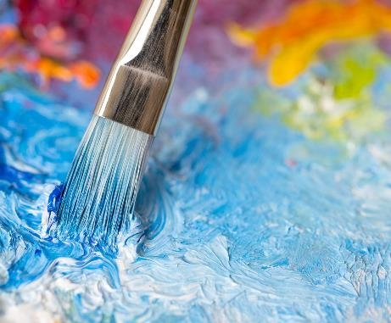
Elements
Drawing and sketching
Painting and colour
Sculpture
Collage and Textiles
Printing
All encompassed by the Experience and Inspiration element

Slide 5


Drawing and Sketching
Threads
1. People, form and use of pencil
2. Line drawing

Slide 6
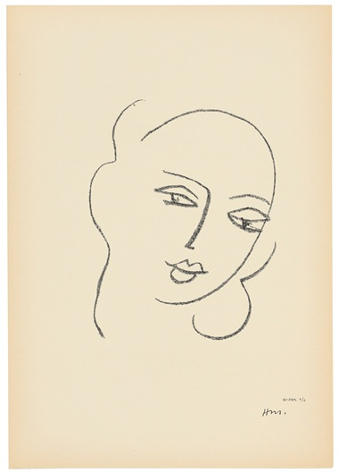
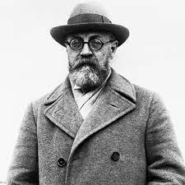
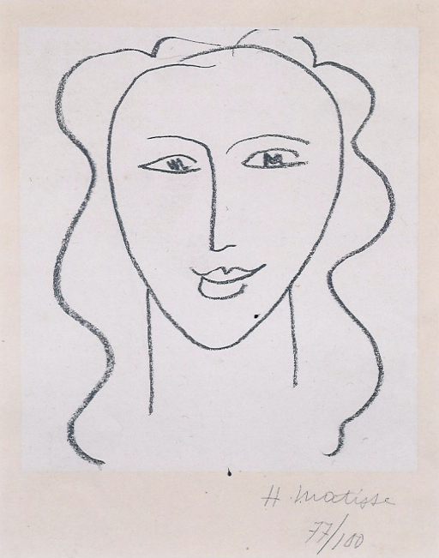
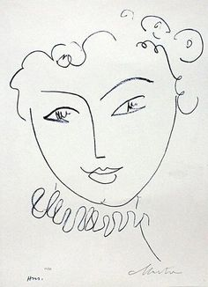
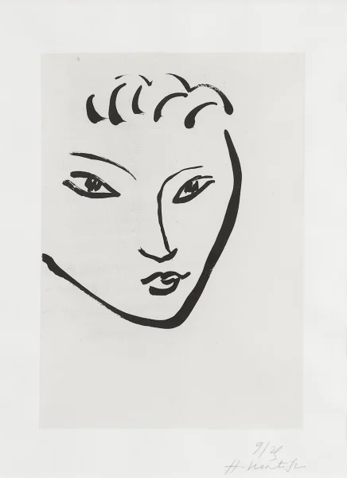
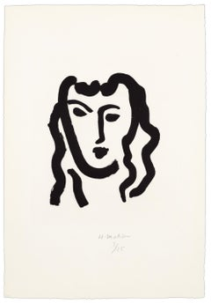
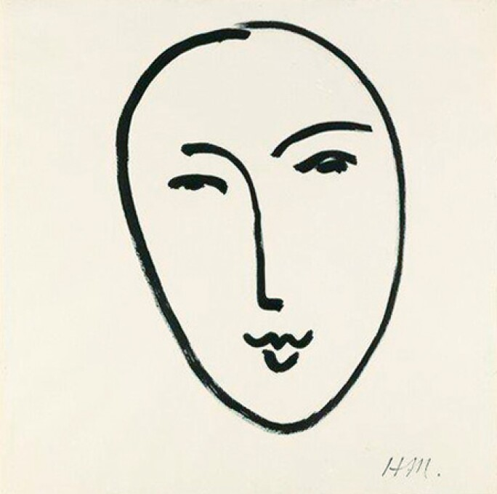
Early Years
Thread 1
Inspiration
Henri Matisse
Pencil control
Different media
Experience
Simple shapes
Facial features

Slide 7
Knowledge
Factual
Procedural and Experimental
Simple sketches can be used to start artwork.
A sketch is a rough drawing or painting, to help make a finished picture later.
Explore using different media to draw. (pencil, chalk, paint)
Hold a pencil correctly.
Draw representations of people.
Add details to drawings including emotions on faces.
Talk about what I want to draw.
Talk about what I have drawn.
Key vocabulary; draw, pencil grip

Slide 8
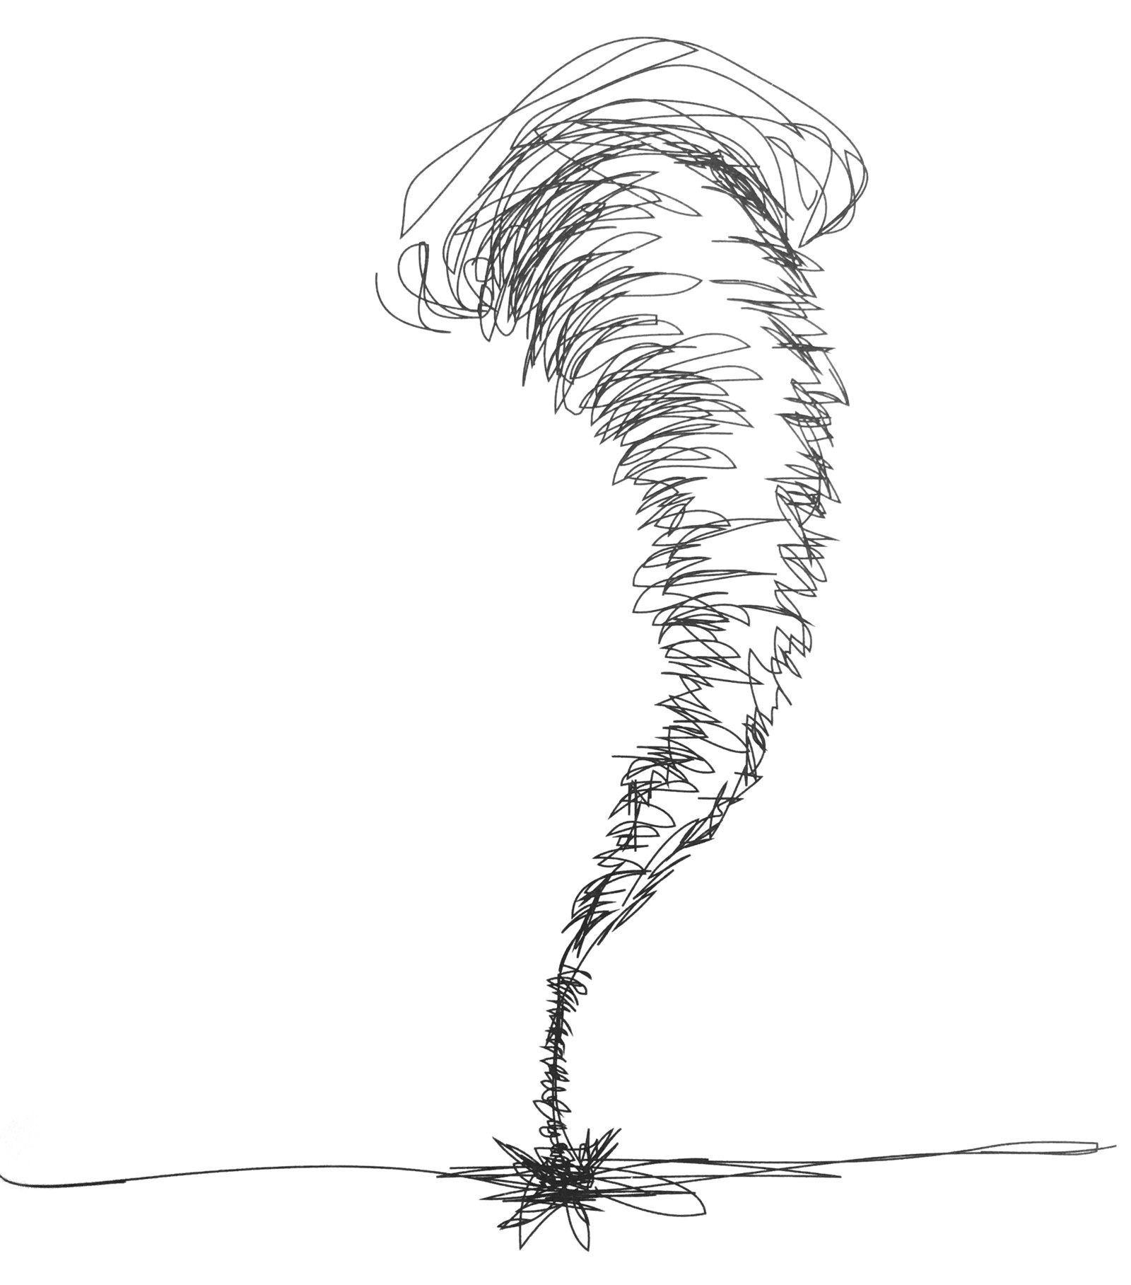



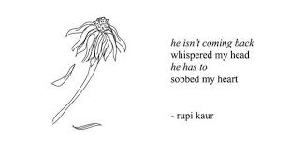
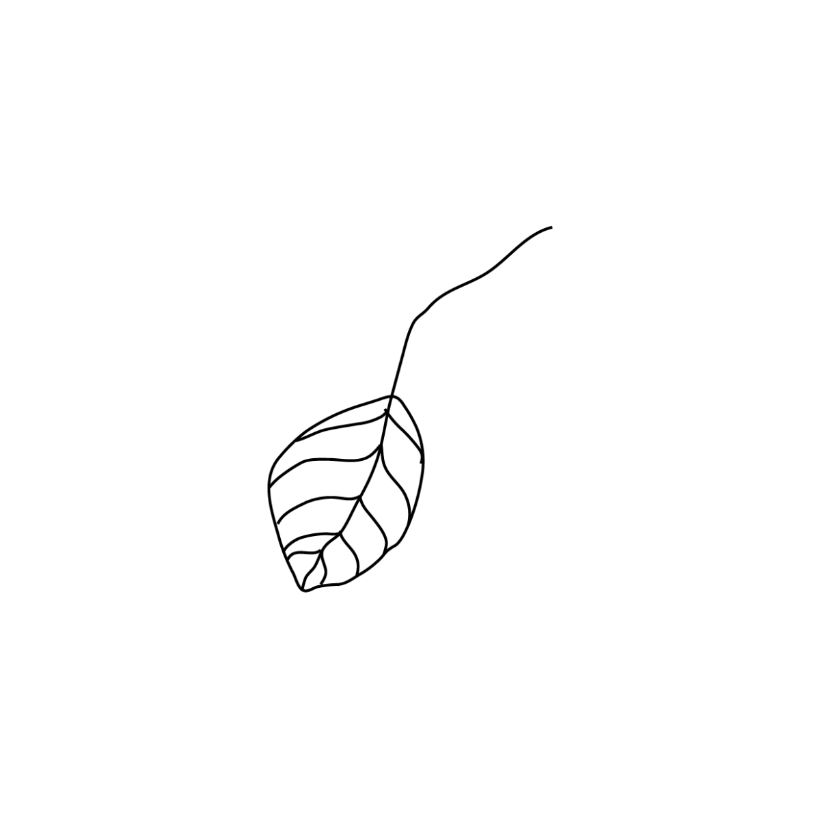
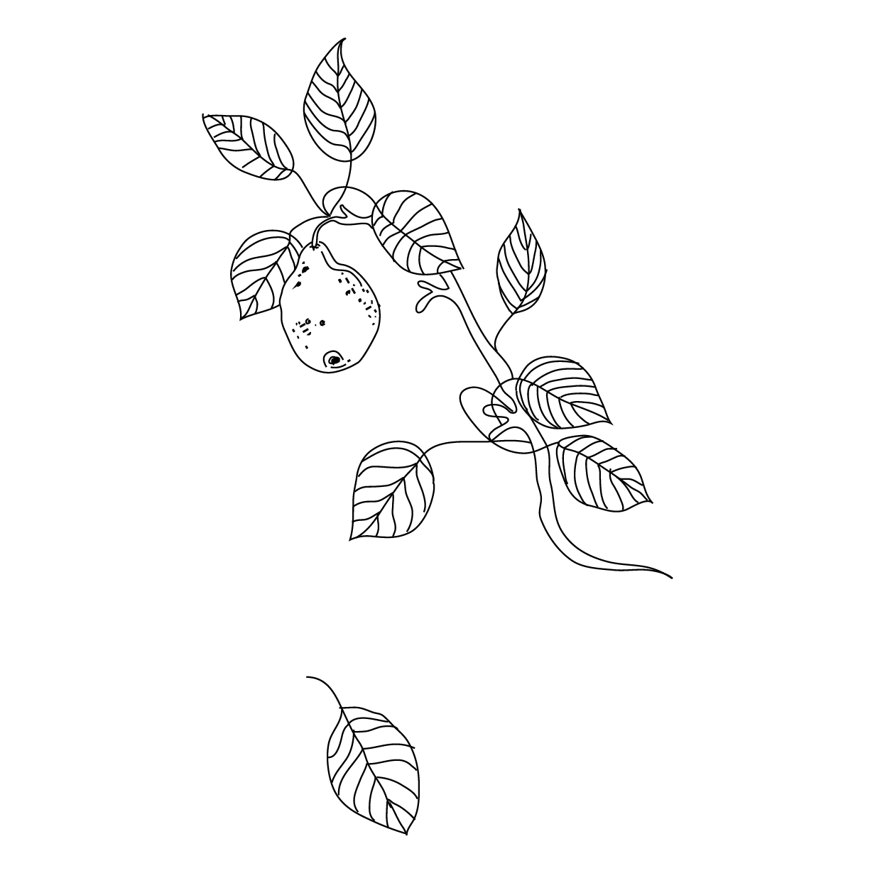
Year 1
Thread 2
Inspiration
Rupi Kaur
Pencil control
Pencil pressure
Experience
Lines to show motion
Some detail

Slide 9
Knowledge
Factual
Procedural and Experimental
Sketches are sometimes the finished piece of art
An illustrator is someone who makes or draws pictures for books or magazines
Draw lines of varying thickness;
Apply varied amounts of pressure to change the thickness and darkness of lines created using a pencil.
Use different materials to draw (pencil, pens)
Show movement using lines
Use key vocabulary to demonstrate knowledge and understanding in this strand: illustration, drawings, line, size, thickness, darkness, movement

Slide 10
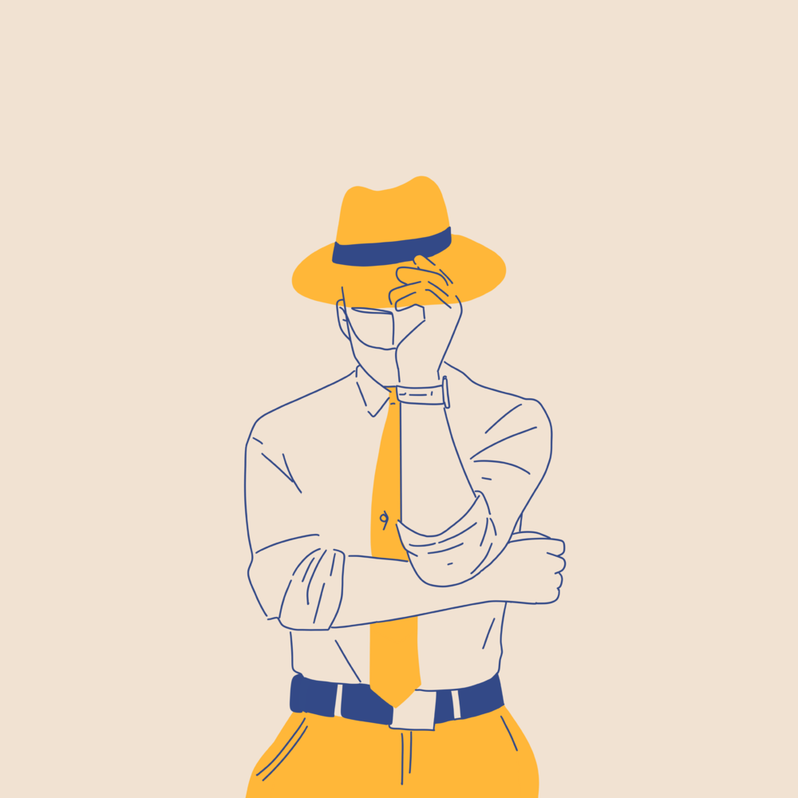

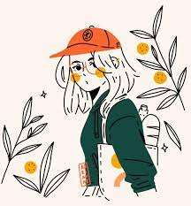
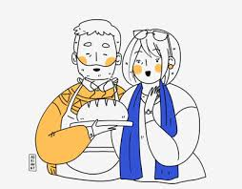
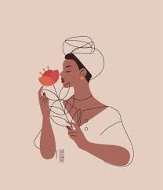
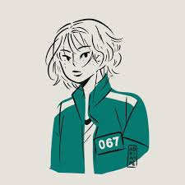
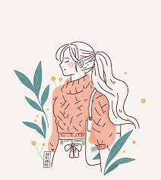
Year 2
Thread 2
Inspiration
Adrianne Walujo
Use of colour and pattern
Observational drawing
Experience
Lines to show motion
Some detail

Slide 11
Knowledge
Factual
Procedural and Experimental
Some artists’ work is in a minimalist style.
Minimalist art is very simple.
Texture is the look and feel of a piece of art.
Use dots and lines to demonstrate texture.
Use a variety of mark making techniques to show pattern.
Use different materials to draw and make preferences based upon their properties. (pencil, pens, highlighters, felt tips, chalk)
Use and understand key vocabulary: line drawing, detail, texture, pattern.

Slide 12
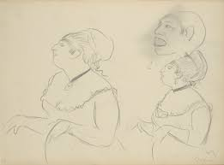
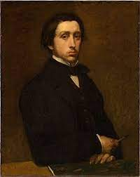
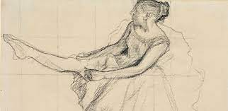
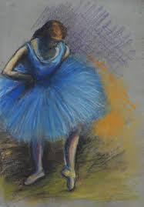
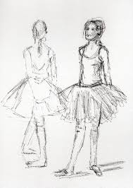
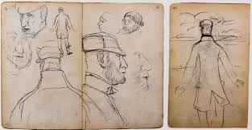
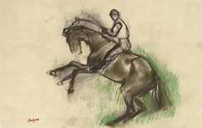
Year 3
Thread 1
Inspiration
Edgar Degas
Use of marks to show shade
Observational drawing of form
Experience
Many sketches of the same thing
Pick out important detail

Slide 13
Knowledge
Factual
Procedural and Experimental
Some artists sketch all the time so they can use the sketches in their paintings.
Impressionist artists create art that shows the impression of how things look to them.
Proportion is comparing the size of something to something else.
Shadow is a darker area of a piece of art where light has been blocked by an object.
Use different materials to draw, (pencils, pastels and chalks)
Use pressure to show light and shadow.
Use mark making to support proportions when drawing.
Use key vocabulary portrait, light, dark, shadow, line, form, shape, outline.
Gather ideas by making observations.

Slide 14
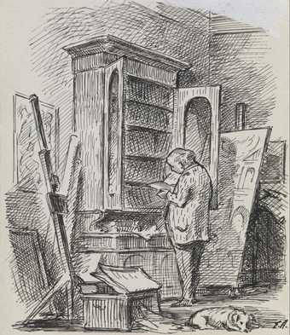
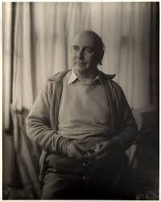
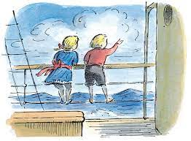
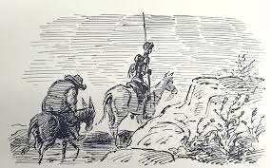
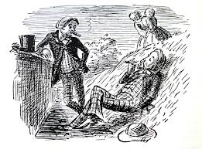
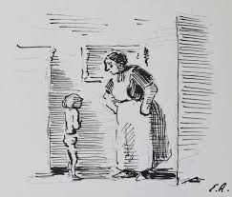
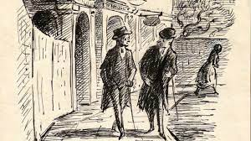
Year 4
Thread 2
Inspiration
Edward Ardizzone
Use of marks to show shade
Observational drawing includes background
Experience
The detail of the sketch
Pick out important detail

Slide 15
Knowledge
Factual
Procedural and Experimental
Some artists add colour to a sketching style to make finished pieces of art.
Tone in drawing is the way that light falls on objects to create light and shadow.
Use lines and texture to create shading with different grades of pencils
Use pressure to create different depths of shading.
Show tone using lines and texture.
Use key vocabulary portrait, light, dark, tone, shadow, line, pattern, texture, form, tone

Slide 16
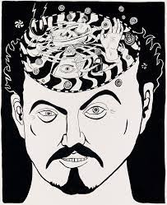
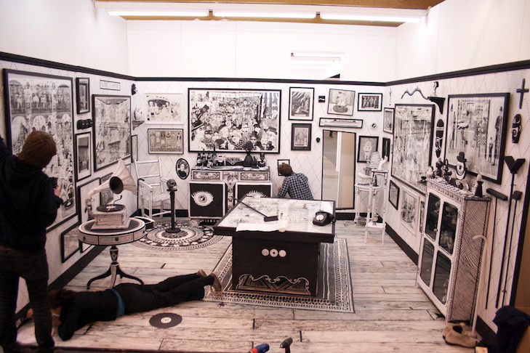
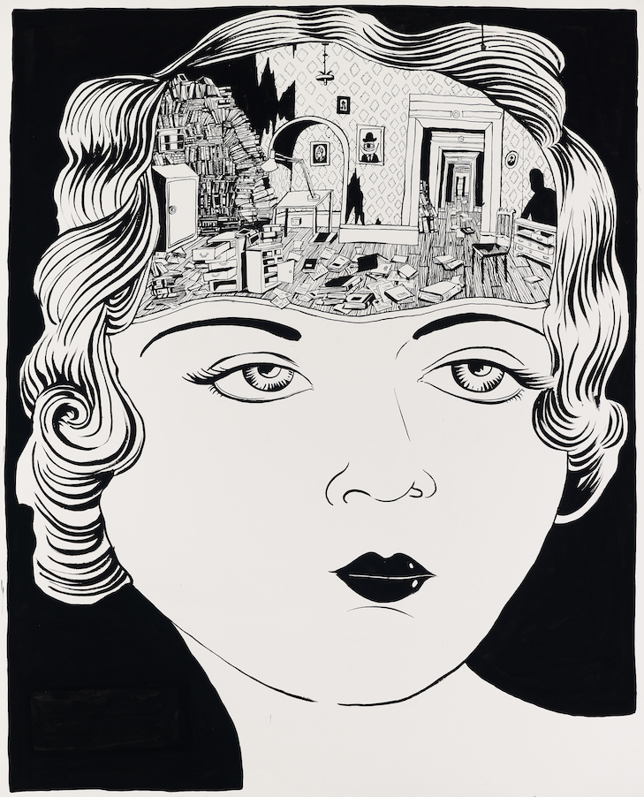
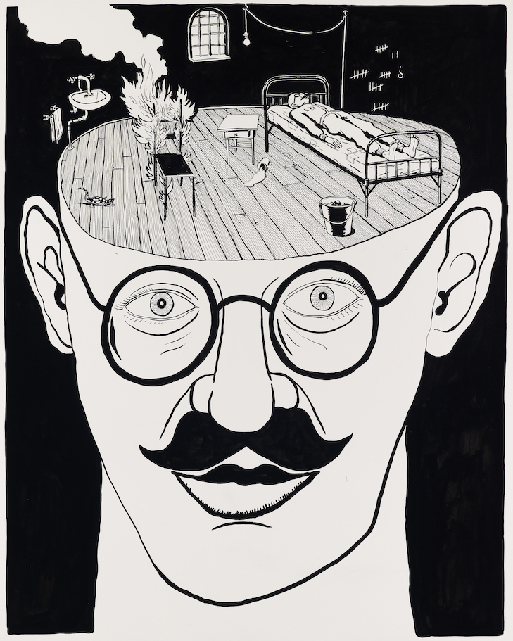
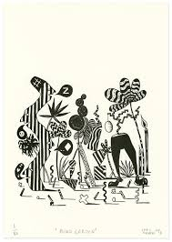
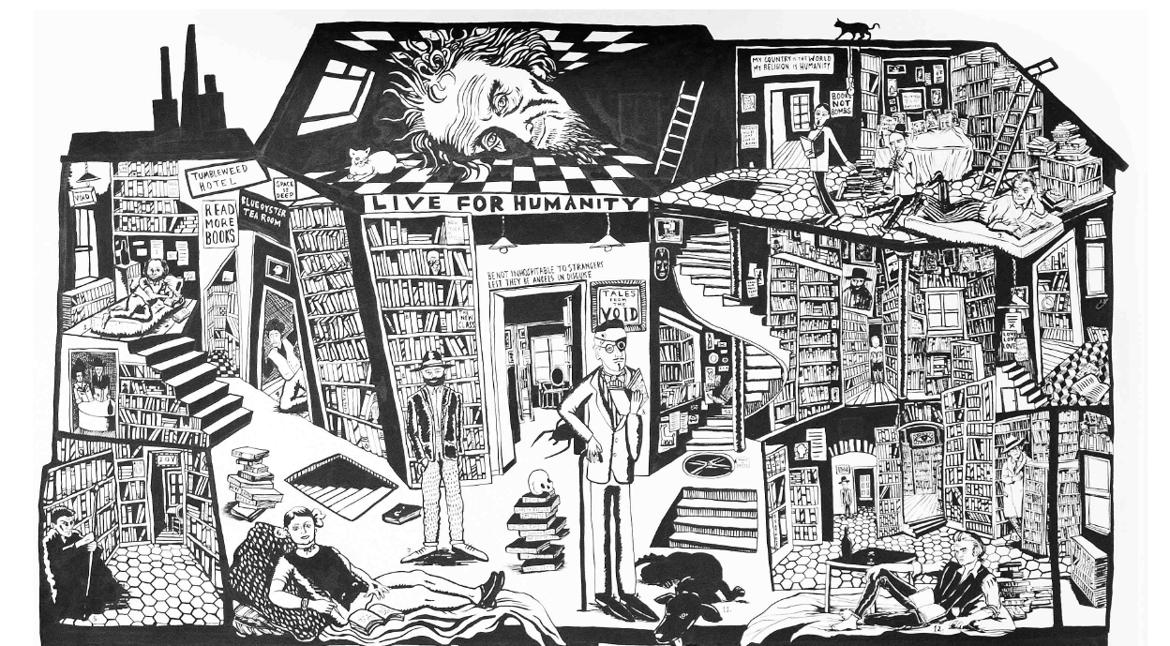
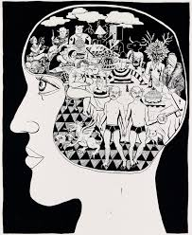
Year 5
Thread 2
Inspiration
The art of Le Gun
Use of pattern
Use of line drawing
Experience
Surreal ideas
Intricate detail

Slide 17
Knowledge
Factual
Procedural and Experimental
Surrealism is not real life, it is an artist trying to show a dreamlike world and just express themselves.
Perspective gives 2D drawings a 3D look.
Use a variety of techniques to add shading and shadow (hatching and cross-hatching).
Use perspective in drawings.
Select the most appropriate tool for drawing (pencil, pen and ink)
Use key vocabulary: line, texture, pattern, form, shape, tone, smudge, blend, mark, perspective

Slide 18
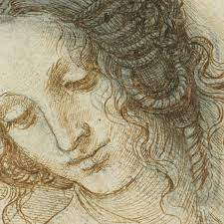
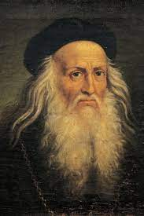
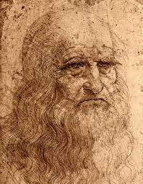
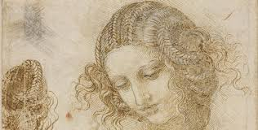
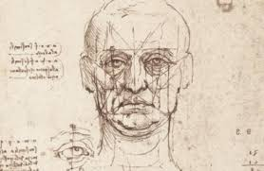
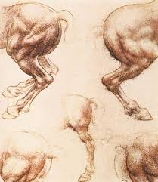
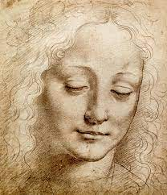
Year 6
Thread 1
Inspiration
Leonardo da Vinci
Use of shading
Experience
Proportion and perspective
Intricate detail

Slide 19
Knowledge
Factual
Procedural and Experimental
Some sketches are very accurate using correct proportions and anatomy.
Anatomical drawings are very precise drawings of the human body.
Use a variety of techniques to add effects – scumble, smudge, blend
Depict movement in drawings.
Use space to plan my drawings.
Use a variety of tools and media selecting the most appropriate.
Use key vocabulary: line, texture, pattern, form, shape, tone, smudge, blend, mark, spacial awareness

Slide 20
Painting and Colour
Threads
Portrait
Landscape

Slide 21
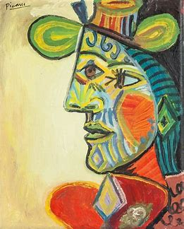






Early Years
Thread 1
Inspiration
Picasso
Paint texture
Mixing colours
Experience
Primary colours
Facial features

Slide 22
Knowledge
Factual
Procedural and Experimental
The primary colours are red, blue and yellow.
A portrait is a picture of someone, usually just their head and shoulders.
Cubism is a type of art that creates pictures showing things from different angles all in one go.
Hold a paintbrush correctly.
Create simple representations of people using paint.
Explore what happens when I mix colours.
Talk about what I have painted.
Explore changing the texture of paint.

Slide 23







Year 1
Thread 2
Inspiration
Etal Adnan
Warm and cold colours
Secondary colours
Experience
Landscape
Painting tools

Slide 24
Knowledge
Factual
Procedural and Experimental
The secondary colours are green, orange and purple.
Secondary colours are made by mixing primary colours.
A landscape is a picture of an area of land or water.
Expressionist artists create art that isn’t realistic, it shows the artists feelings.
Experiment with different brushes and other painting tools. (paintbrush, spatula, sponge)
Mix primary colours to make secondary colours.
Identify which colours are warm and which are cool.
Use key vocabulary to demonstrate knowledge and understanding in this strand: primary colours, secondary colours, warm colours, cool colours, brushstroke.

Slide 25







Year 2
Thread 2
Inspiration
L S Lowry
Paint types
Simple figures
Experience
Tints and shades
Shapes

Slide 26
Knowledge
Factual
Procedural and Experimental
A tint of a colour is when we add white to a colour to make it lighter.
A shade of a colour is when we add black to a colour to make it darker.
Landscapes can have people in them but the focus of the picture is the land or water.
Place primary and secondary colours on a colour wheel.
Experiment with paints - acrylic paint, watercolours.
Add white and black to precisely alter tints and shades.
Use key vocabulary to demonstrate knowledge and understanding in this strand: watercolour wash, acrylic, tint, shade

Slide 27







Year 3
Thread 1
Inspiration
Vincent van Gogh
Texture
Paint effects
Experience
Layering
Background

Slide 28
Knowledge
Factual
Procedural and Experimental
A hue is a colour which has not had anything added to it to make it a tint or shade.
A self portrait is when an artist paints themselves.
Choose brushes to use with paint type and create shape and texture.
Mix colours effectively when using watercolour to create the hue and depth of colour.
Understand the paint can be layered to create a depth of colour.
Consider what to do in a painting’s background.
Use key vocabulary - hue, depth, background

Slide 29







Year 4
Thread 2
Inspiration
David Hockney
Background
Vocabulary
Experience
Middle ground
Foreround

Slide 30
Knowledge
Factual
Procedural and Experimental
Paintings can be split into foreground (at the front), middle ground and background.
Some artists landscapes are imaginative and not very realistic.
Choose brushes to use with paint type and use varied brush techniques to create shapes, textures, patterns and lines.
Mix colours effectively using watercolours and acrylics using the correct language, tint, shade, primary and secondary.
Lighten or darken colours using both black and white but also yellow and blue.
Use key vocabulary: foreground, middle ground, background.

Slide 31







Year 5
Thread 2
Inspiration
Amy Bennett
Colour palette
Experience
Details
Hues of one colour

Slide 32
Knowledge
Factual
Procedural and Experimental
Some artists landscapes are very realistic and show exactly what the artist could see.
A colour palette is the range of colours an artist uses in their work. These are the only colours you will see in their paintings.
A tone of a colour is when we add grey to make it lighter or darker.
Create a colour palette, demonstrating mixing techniques to create a wide range of tone and hue.
Use oil paints and water colours to create visually interesting pieces which use a variety of hue and tone in the same colour.
Use key vocabulary blend, palette, tone

Slide 33







Year 6
Thread 1
Inspiration
Kehinde Wiley
Experience

Slide 34
Knowledge
Factual
Procedural and Experimental
Portraits have been used for hundreds of years as a symbol of wealth.
Artists choose the subjects of their portraits for many reasons.
Understand how to make a colour warmer or colder.
Use colour to make the focus or subject of a painting stand out.
Use key vocabulary warmer, colder, focus, subject

Slide 35
Sculpture
Threads
Human form
Abstract form

Slide 36







Early Years
Thread 1
Inspiration
Constantin Brancusi
Texture
Use of shape
Experience
Facial features
Colour

Slide 37
Knowledge
Factual
Procedural and Experimental
Modernist artists try new ideas and ways of doing things.
A sculpture is a form of art where you make 3D pieces by moulding, joining or carving.
A statue is a life size sculpture of people or animals.
Create a sculpture representation of the human face.
Explore using my hands to mould dough and clay by pinching, rolling and pulling.
Talk about what I have created and materials I have used.
Key vocabulary – sculpture, statue

Slide 38







Year 1
Thread 2
Inspiration
Anish Kapoor
Texture
Use of shape
Experience
Size
Colour

Slide 39
Knowledge
Factual
Procedural and Experimental
Abstract artists create artwork that don’t look like anything from the real world.
A sculpture can be any size.
Use a variety of recycled materials for sculpting.
Compare sculpting in recycled materials to dough.
Use a variety of shapes when sculpting.
Key vocabulary - work of art, 3D, sculptor, materials, abstract,

Slide 40







Year 2
Thread 2
Inspiration
Sol LeWitt
Material
Use of shape
Experience
Size
Colour

Slide 41
Knowledge
Factual
Procedural and Experimental
Minimalist artists can also use other styles such as abstract.
A sculpture can be made of anything the artist wants to use.
Use a variety of natural, recycled and manufactured materials for sculpting. (clay, straws and card)
Use a variety of techniques. (rolling, cutting, pinching, folding.)
Compare the use of line in drawings and sculpture.
Key vocabulary - installation, shapes, geometric, line

Slide 42







Year 3
Thread 1
Inspiration
Henry Moore
Material
Use of shape
Experience
Method
Human form

Slide 43
Knowledge
Factual
Procedural and Experimental
When a sculpture looks a bit like something real, it can be called semi-abstract art.
Artists often choose a material they like to work with – this is their preferred media.
Compare using clay and Modroc to find a preference
Join malleable materials using fingers and tools to smooth joins.
Key vocabulary – form, join, malleable, preference, media, mod roc

Slide 44







Year 4
Thread 2
Inspiration
Louise Bourgeois
Material
Use of shape
Experience
Feeling
Organic subjects

Slide 45
Knowledge
Factual
Procedural and Experimental
Contemporary art can be anything produced over the last century.
Some artists produce work to make you feel a certain way.
Use tools and materials to carve, add shape, add texture and pattern.
Join clay structures using slip.
Use the clay building techniques coiling and slabbing.
Key vocabulary – coiling, slabbing, slip

Slide 46







Year 5
Thread 2
Inspiration
Anselm Kiefer
Material
Different elements
Experience
Feeling
Size

Slide 47
Knowledge
Factual
Procedural and Experimental
Artists can mix styles in their work such as contemporary and semi abstract.
Some artists cast their sculptures out of metal.
Plan and design a sculpture;
Develop cutting and joining skills using wire.
Choose from a range of materials to create a 3D sculpture;
Key vocabulary - structure, cast, wire

Slide 48







Year 6
Thread 1
Inspiration
Alberto Giacometti
Material
Proportion
Experience
Movement
Size

Slide 49
Knowledge
Factual
Procedural and Experimental
Some artists can mix styles in their work such as contemporary and expressionist.
Proportion is important in all art forms.
Use real life sketches to create a sculpture.
Use wire as the structural basis for a clay sculpture.
Discuss the pros and cons of different materials.
Key vocabulary – structural, pros, cons

Slide 50
Collage and Textiles
Threads
Textiles
Collage

Slide 51







Early Years
Thread 1
Inspiration
Annie Albers
Experience

Slide 52
Knowledge
Factual
Procedural and Experimental
Art that use materials and fabrics is known as textiles.
Weaving is interlacing different fabrics and colours.
Talk about the different textures of materials.
Join different materials together using a simple knot..
Show pattern by weaving a simple square.
Decorate textiles with glue to add colour and detail.
Talk about my creation and choice of materials.
Key vocabulary – weave, material, textiles, interlacing, over, under

Slide 53







Year 1
Thread 1
Inspiration
Judith Scott
Experience

Slide 54
Knowledge
Factual
Procedural and Experimental
Anyone can be an artist regardless of age, health, skin colour or disability.
Some artists use everyday objects within their art.
Use a dyeing technique to alter a textile’s colour and pattern.
Decorate textiles with stitching, to add colour and detail.
Key vocabulary - decoration, decorative, dye, needle, thread, stitch.

Slide 55







Year 2
Thread 2
Inspiration
Edward Ruscha
Experience

Slide 56
Knowledge
Factual
Procedural and Experimental
Collage is to stick together bits of things to form a piece of art.
Lots of artists use words in their art to give a message.
Use materials that have been cut, torn and glued.
Arrange materials carefully.
Use a mixture of materials to add texture.
Key knowledge - collage, squares, cut, place, arrange, tear

Slide 57







Year 3
Thread 1
Inspiration
El Anatsui
Experience

Slide 58
Knowledge
Factual
Procedural and Experimental
Some textile artists use materials like metal or plastic to create textile art.
Experiment with a range of media by overlapping and layering in order to create texture, effect and colour. (sweet wrappers, tissue paper, bottle tops, CDs, cardboard)
Add decoration to create effect.
Design a piece of textile art.
Key vocabulary – overlap, layer, join, design

Slide 59







Year 4
Thread 2
Inspiration
Kara Walker
Experience

Slide 60
Knowledge
Factual
Procedural and Experimental
Some artists have a focus for all their artwork such as black history, animals or flowers.
Select colours and materials to create effect and give reasons for my choices.
Refine my work as I go to ensure precision.
Practise a variety of collage techniques (overlapping, silhouette and tessellation) to make artwork.
Key Knowledge - tessellation, silhouette, precision

Slide 61







Year 5
Thread 1
Inspiration
Alexandra Kehayoglou
Experience

Slide 62
Knowledge
Factual
Procedural and Experimental
Dyeing material is like creating a colour palette as a painter. Artists can create a range of hues for their work.
Some artists take inspiration from the Earth and the land.
Any type of art can create a landscape, not just drawing and painting.
Select appropriate materials, giving reasons.
Use a variety of techniques, ( printing, dyeing, weaving and stitching) to create different textural effects.
Develop skills in stitching, cutting and joining.
Key Vocabulary - texture, colour, shape, stuffing, shades, hue, landscape, inspiration

Slide 63







Year 6
Thread 2
Inspiration
Njideka Akunyili Crosby
Experience

Slide 64
Knowledge
Factual
Procedural and Experimental
A mosaic is made up of lots of small, coloured pieces of material to form a picture.
Some artists use everyday life as the inspiration for their art.
Add collage to a painted or printed background.
Create and arrange accurate patterns.
Plan and design a collage.
Key Vocabulary - mosaic, accurate.

Slide 65
Printing
Threads
Collagraphy
Relief
Mono

Slide 66







Early Years
Thread 3
Inspiration
Claire Haxby
print
fabric
Experience
Hapa-zome
floral

Slide 67
Knowledge
Factual
Procedural and Experimental
Some artists print using an object.
Not all printing is on paper.
A print in art is transferring something from one thing to another.
Explore printing using different objects, (sponges, food, fabric)
Mono print using foil and felt pens.
Use Hapa-Zome to print.
Talk about how I have printed something and why I chose what to print with.
Key vocabulary – print, object, printing, Hapa-Zome, floral

Slide 68







Year 1
Thread 1
Inspiration
Tuyo
Recycled materials
detail
Experience
Mono colour
collagraphy

Slide 69
Knowledge
Factual
Procedural and Experimental
Collagraphy printing is sticking things onto a board to print from.
Mono colour means only in one colour. (but can be lighter or darker options of the same colour)
Copy an original print.
Use recycled materials to create a collagraphy print.
Show detail on a mono colour print through the use of different materials.
Key vocabulary – mono colour, shape, printmaking,

Slide 70







Year 2
Thread 1
Inspiration
Conita Kent
reverse
Multi colour
Experience
Print block
layering

Slide 71
Knowledge
Factual
Procedural and Experimental
Anyone can be an artist regardless of their job choice.
Printing is a way of mass producing text or images.
Multi colour means more than one colour.
Use a variety of materials (different cardboards, corrugated card, felt, plastic letters) to create print blocks.
Use more than one colour to layer in a print.
Reverse letters to make them print the right way round.
Key vocabulary – layering, accuracy, print block, reverse, multi colour

Slide 72







Year 3
Thread 3
Inspiration
Favianna Rodriguez
marbling
Experience
Mono printing
background

Slide 73
Knowledge
Factual
Procedural and Experimental
Some artists print on to a background they have created.
Paper comes in lots of sizes. They have a letter and then a number.
A mono print is a one off design, it cannot be mass produced from a block.
Use different techniques to make a background for printing on. (wax and watercolour, marbling)
Use plastic sheet to create a mono print
Key vocabulary; background, wax, marbling, mono print

Slide 74







Year 4
Thread 1
Inspiration
William Morris
Experience
layering

Slide 75
Knowledge
Factual
Procedural and Experimental
Printing can be used to create home furnishings like wallpaper.
Some artist’s designs are used to decorate our homes.
Use more than one colour to layer in a print;
Replicate patterns from observations;
Make multiple collagraphy printing blocks and build a printed piece of art;
Make repeated patterns with precision;
Key vocabulary; replicate, multiple, precision

Slide 76







Year 5
Thread 2
Inspiration
Laurie Hastings
ink
Relief printing
Experience
Styrofoam
Eraser carving

Slide 77
Knowledge
Factual
Procedural and Experimental
Relief printing is cutting away of part of the surface of a block of material so that the image area to be printed stands out in relief.
Printing ink is thicker than writing ink so that it doesn’t run off your block.
Design and create printing blocks/tiles on different materials;
Further develop printing techniques by using block relief printing;
Use printing ink
Create and arrange accurate patterns;
Use key vocabulary; printing ink, styrofoam printing tiles, inking rollers.

Slide 78







Year 6
Thread 2
Inspiration
Claire Halifax
Multi block
All printing types
Experience
Intricate
Fabric

Slide 79
Knowledge
Factual
Procedural and Experimental
An artist’s picture’s composition is an important part of the design process for a finished piece of art.
Use different printing types to create one piece of art (collagraphy, mono and relief block)
Decide which parts of a composition should be done with which printing type
Use intricate carving showing detail on relief print blocks
Design and create printing blocks using easy cut rubber blocks
Key Vocabulary; easy cut rubber blocks, intricate. composition

